Slide 1
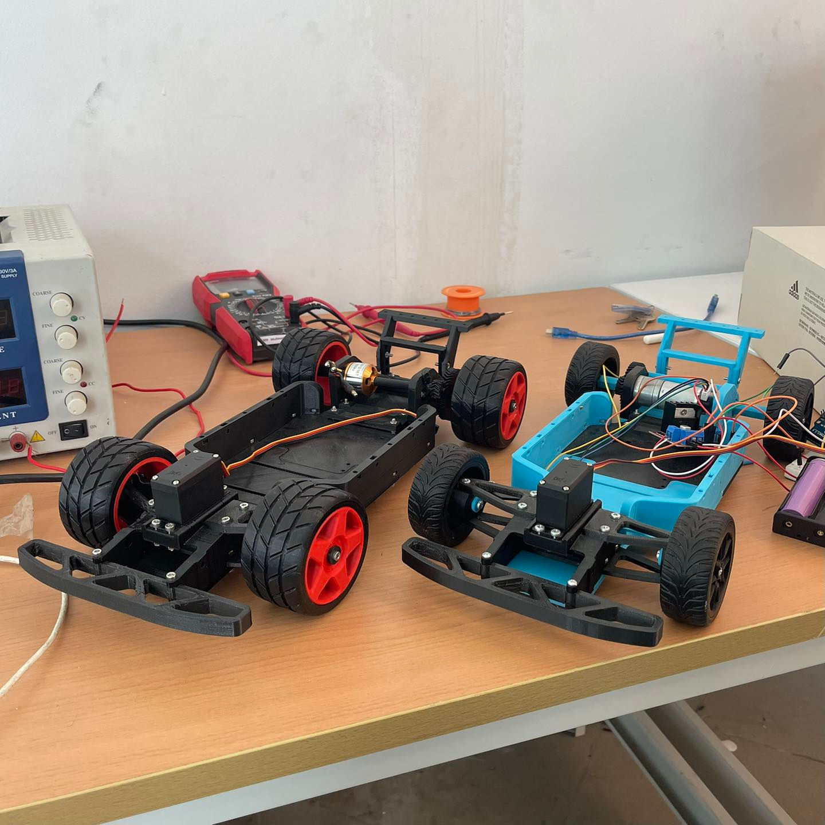



IMAGE PROCESSING PROJECT TEAM-08
NABIL HASSAN
YASSIN EISSA
SHEHAB EL-WAKIL
MOHAMED MOHY
MAHMOUD KATTAN

Slide 2


Milestone 1
Topics
Covered
Milestone 2
Milestone 3
Milestone 4

Slide 3
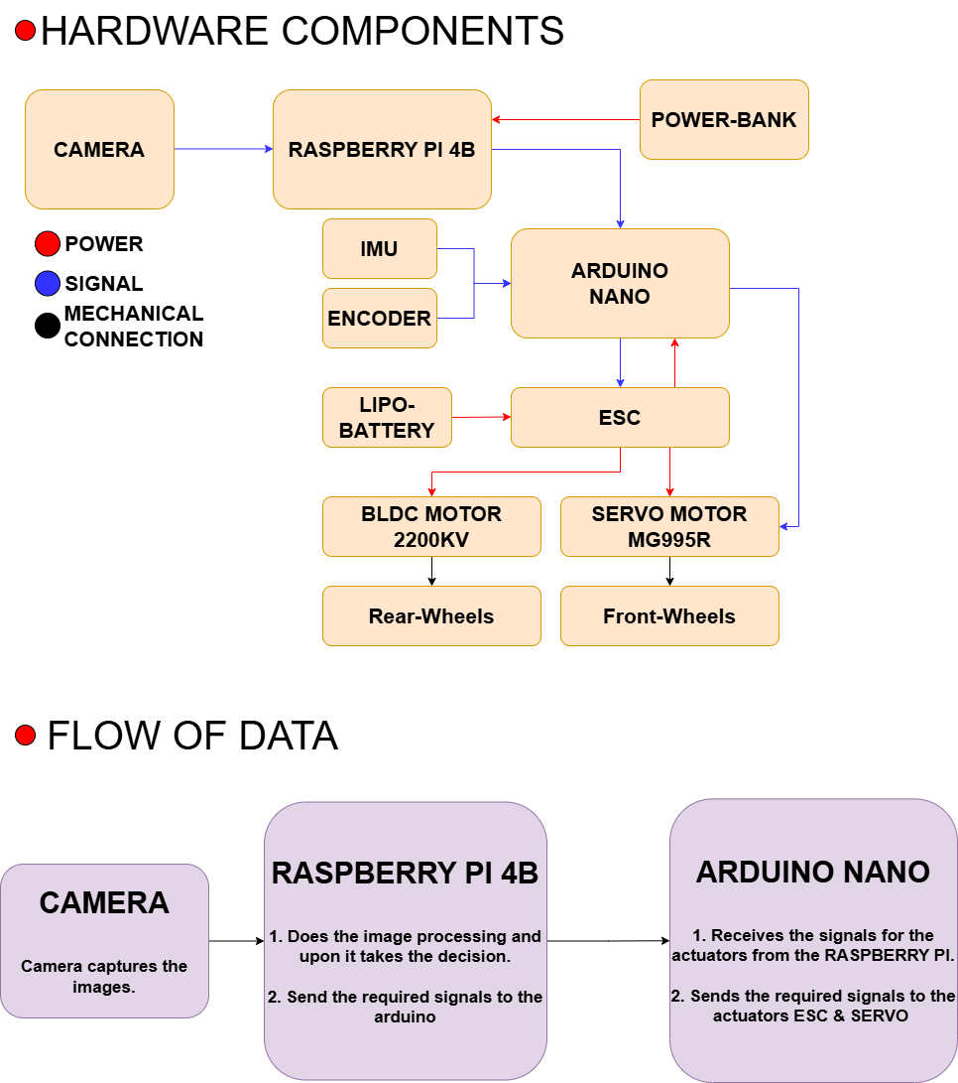
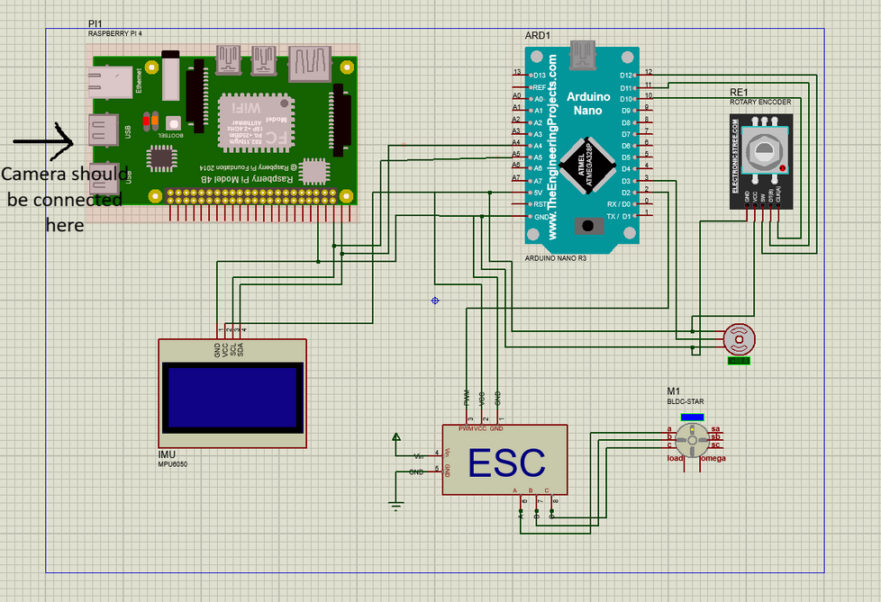
MILESTONE 1
Project Schematics

Slide 4
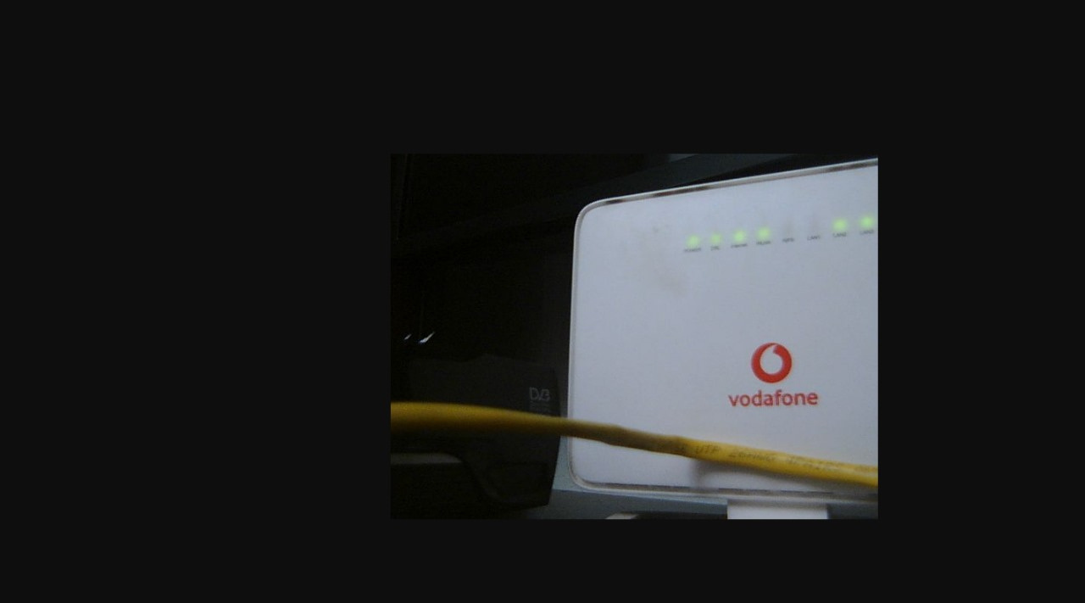
MILESTONE 1
Project Hardware & Camera Picture

Slide 5
MILESTONE 2
Geometric & Intensity Transformations
Edge Detection
Closed-loop image-based control

Slide 6
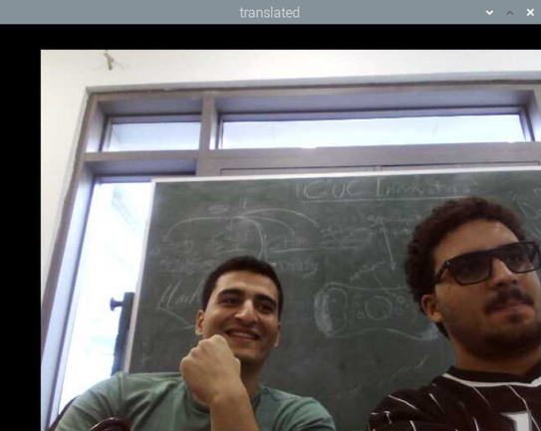
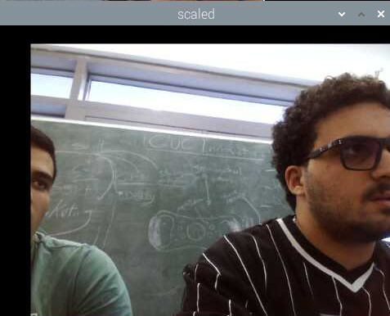
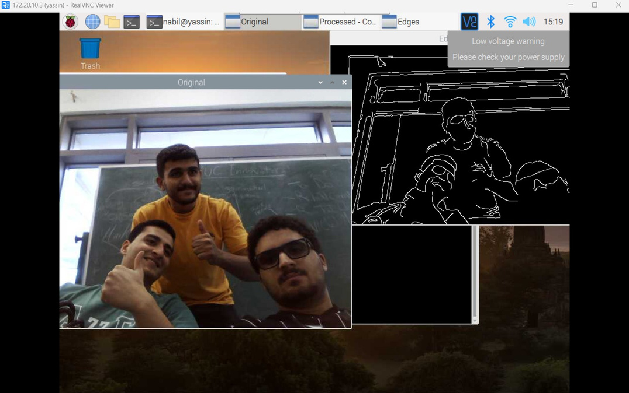
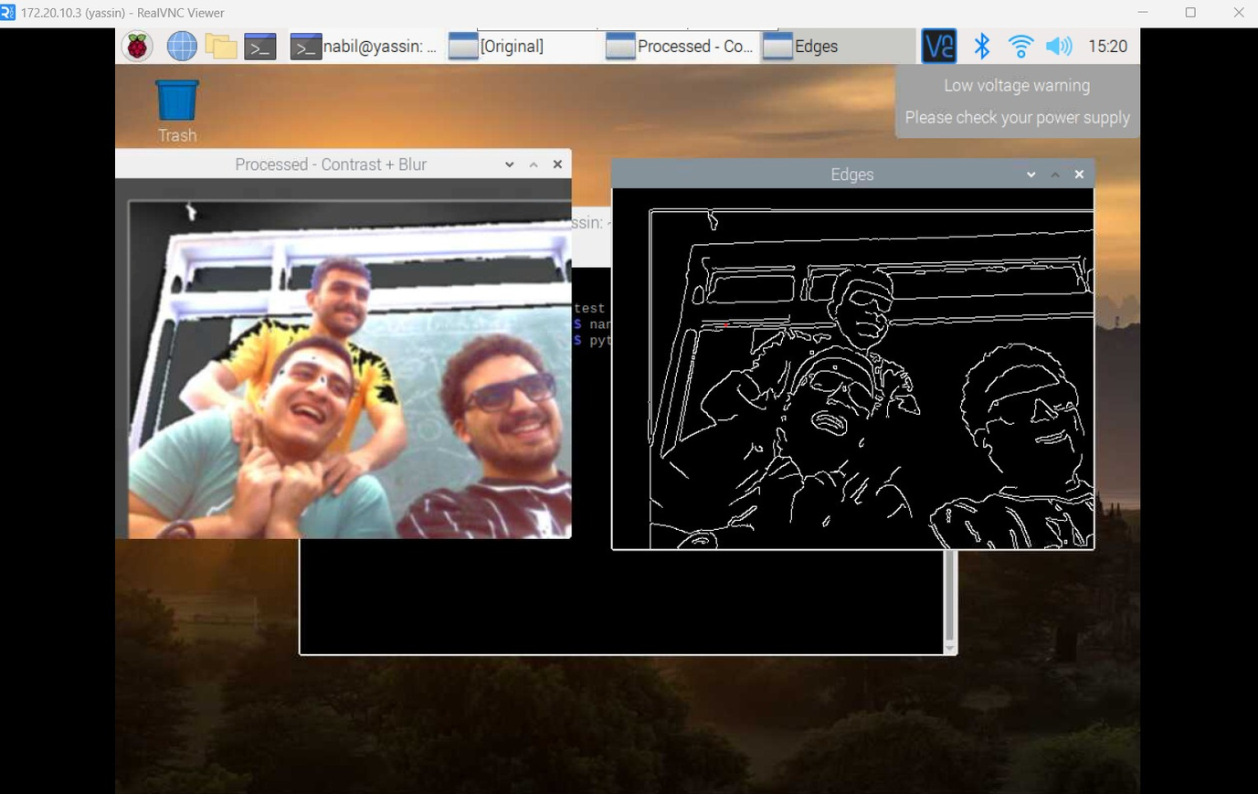
MILESTONE 2
Geometric & Intensity Transformations
Translated
Scaled
Original
Contrast + Blur

Slide 7
MILESTONE 2
Edge Detection
Canny + Blur +Contrast
Canny + original Image

Slide 8
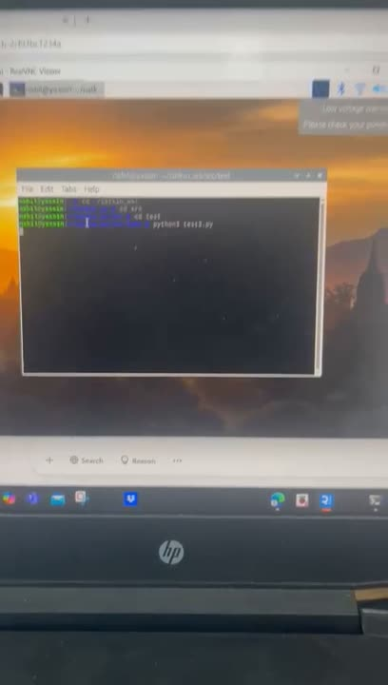
MILESTONE 2
Closed-loop image-based control

Slide 9
MILESTONE 3
Complete and neat hardware
Code uploaded with Raspberry Pi

Slide 10
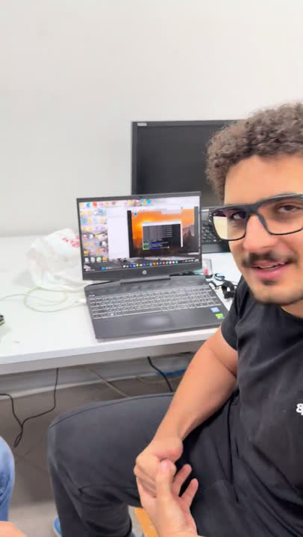
MILESTONE 3
Complete and neat hardware

Slide 11
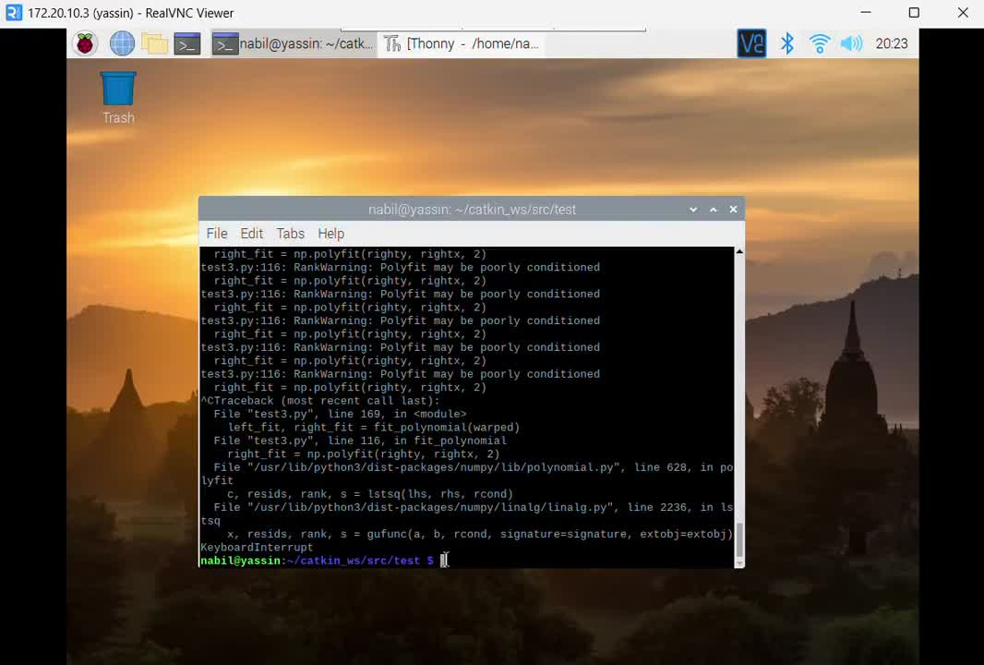
MILESTONE 3
Code uploaded with Raspberry Pi

Slide 12
MILESTONE 4 & 5
Finalized blackbox image-based control
Closed-loop vision-based validation

Slide 13
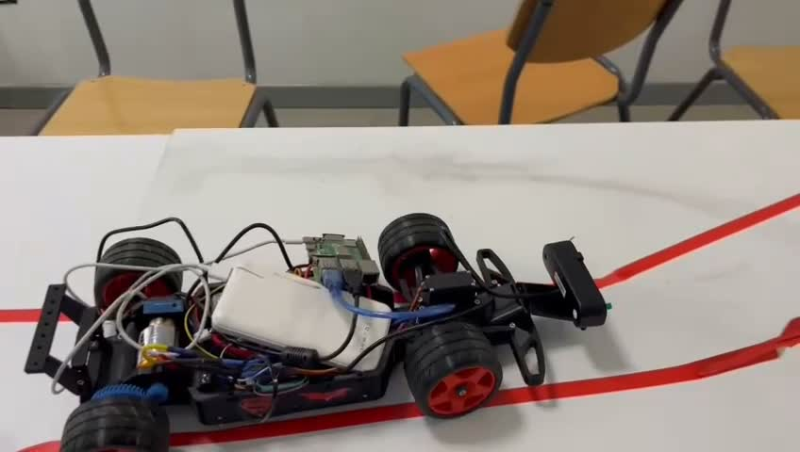
MILESTONE 4 & 5

Slide 14
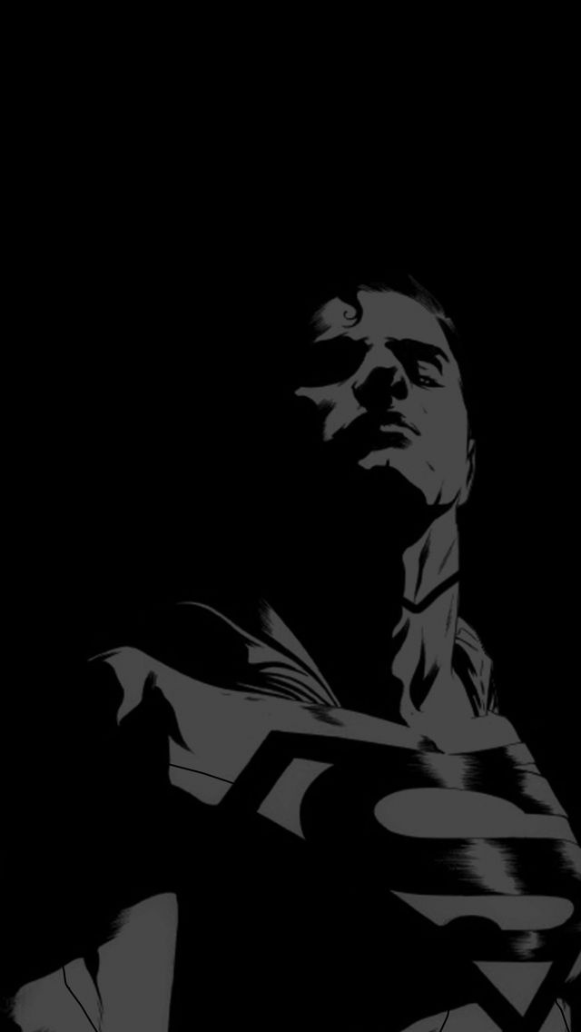
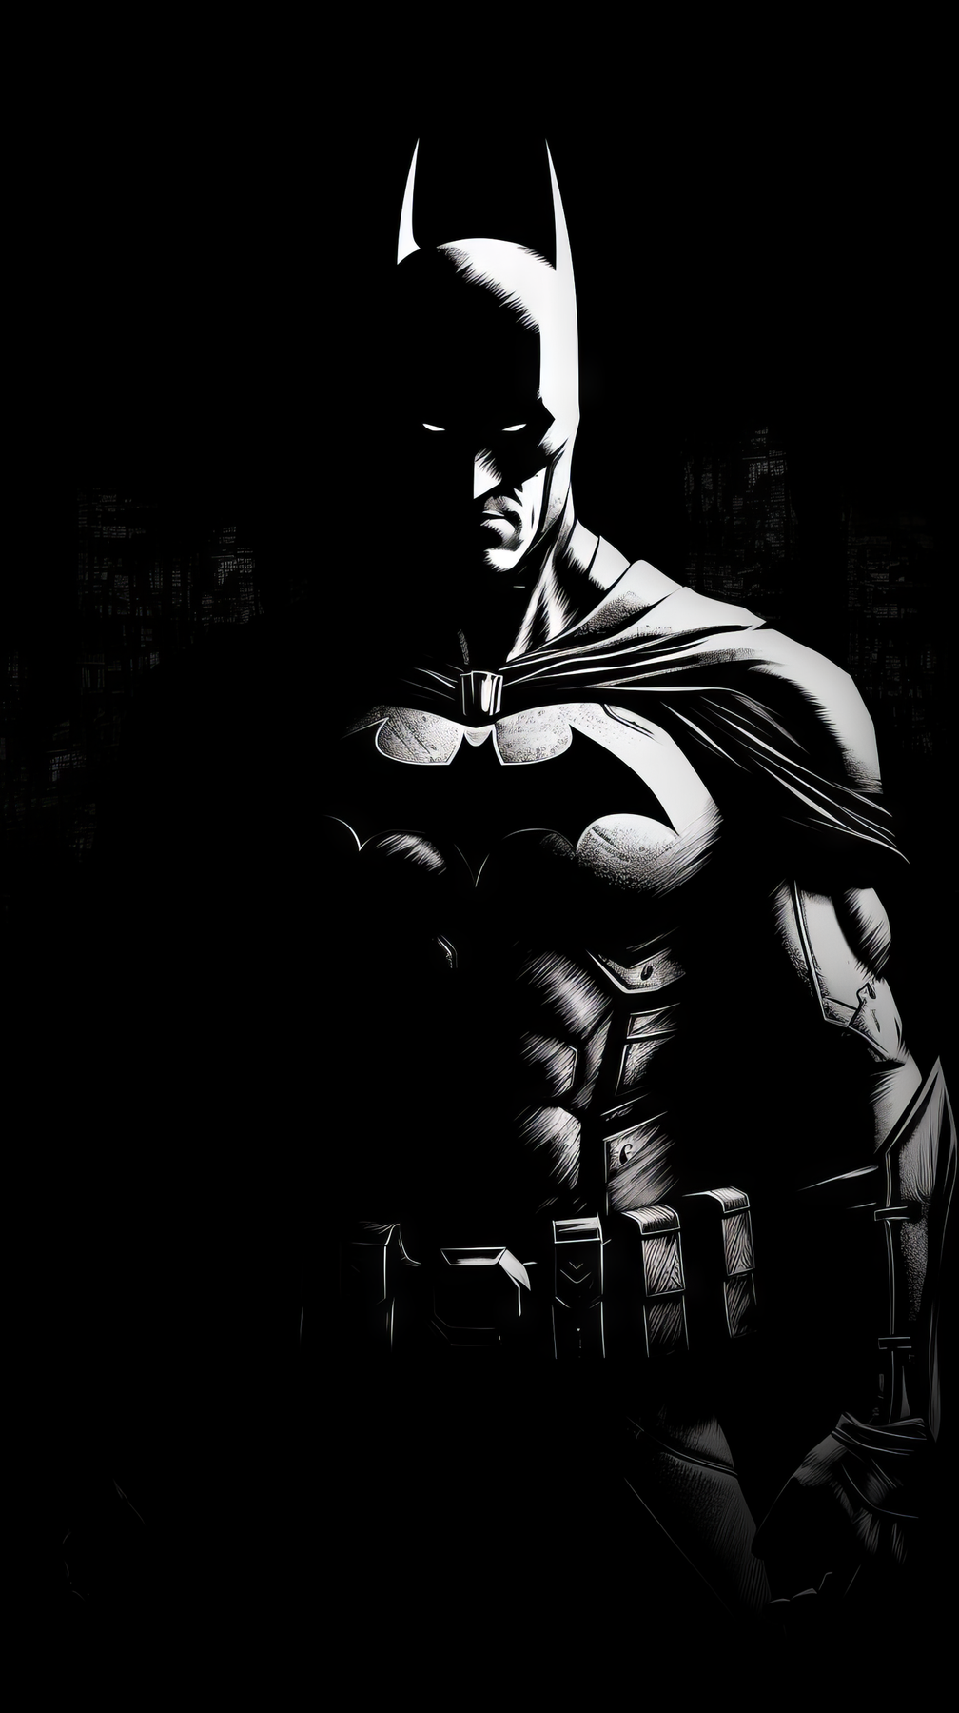
Thank You

